Slide 1
Sprint #3 Presentation
Topikos

Slide 2
Documentation - Sprint #3 Updates
Business Requirements Document (BRD)
Corrected Opportunities and Threats
Management Plan (MP) - NO UPDATE
Product Requirements Document (PRD) - NO UPDATE
Architecture & Design (ADD) - NO UPDATE

Slide 3
S.W.O.T. Analysis
Strengths | Weaknesses
Machine Learning Experience- Two members of our team have previous experience with Machine Learning Resources Available- We have knowledge of easily accessible and available resources for building our app | Individual Skill Sets - Each of us have knowledge and skills in different programming languages and software, which could hinder us since we each will need time to learn new skills Availability -difficult for team members to work on the project due to busy or conflicting class schedules, which could lead to us not making significant progress

Slide 4
S.W.O.T. Analysis - continued
Opportunities | Threats
Mobile app market growth- With more people owning smartphones, this will accelerate the growth of the mobile app market. Increasing use of apps as a news source - In almost all countries, there has been a jump in the use of news apps, especially among younger generations. | Alternative Local News Apps and Websites- KTLA 5 News App and Website, News Break App, SmartNews App Social Media - many people continue to get their news from social media apps, which may leave our app not being used frequently

Slide 5
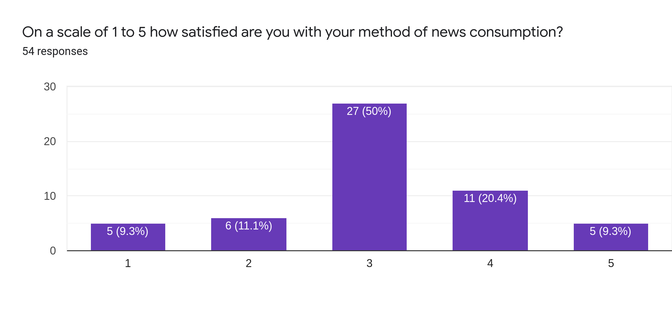

Slide 6
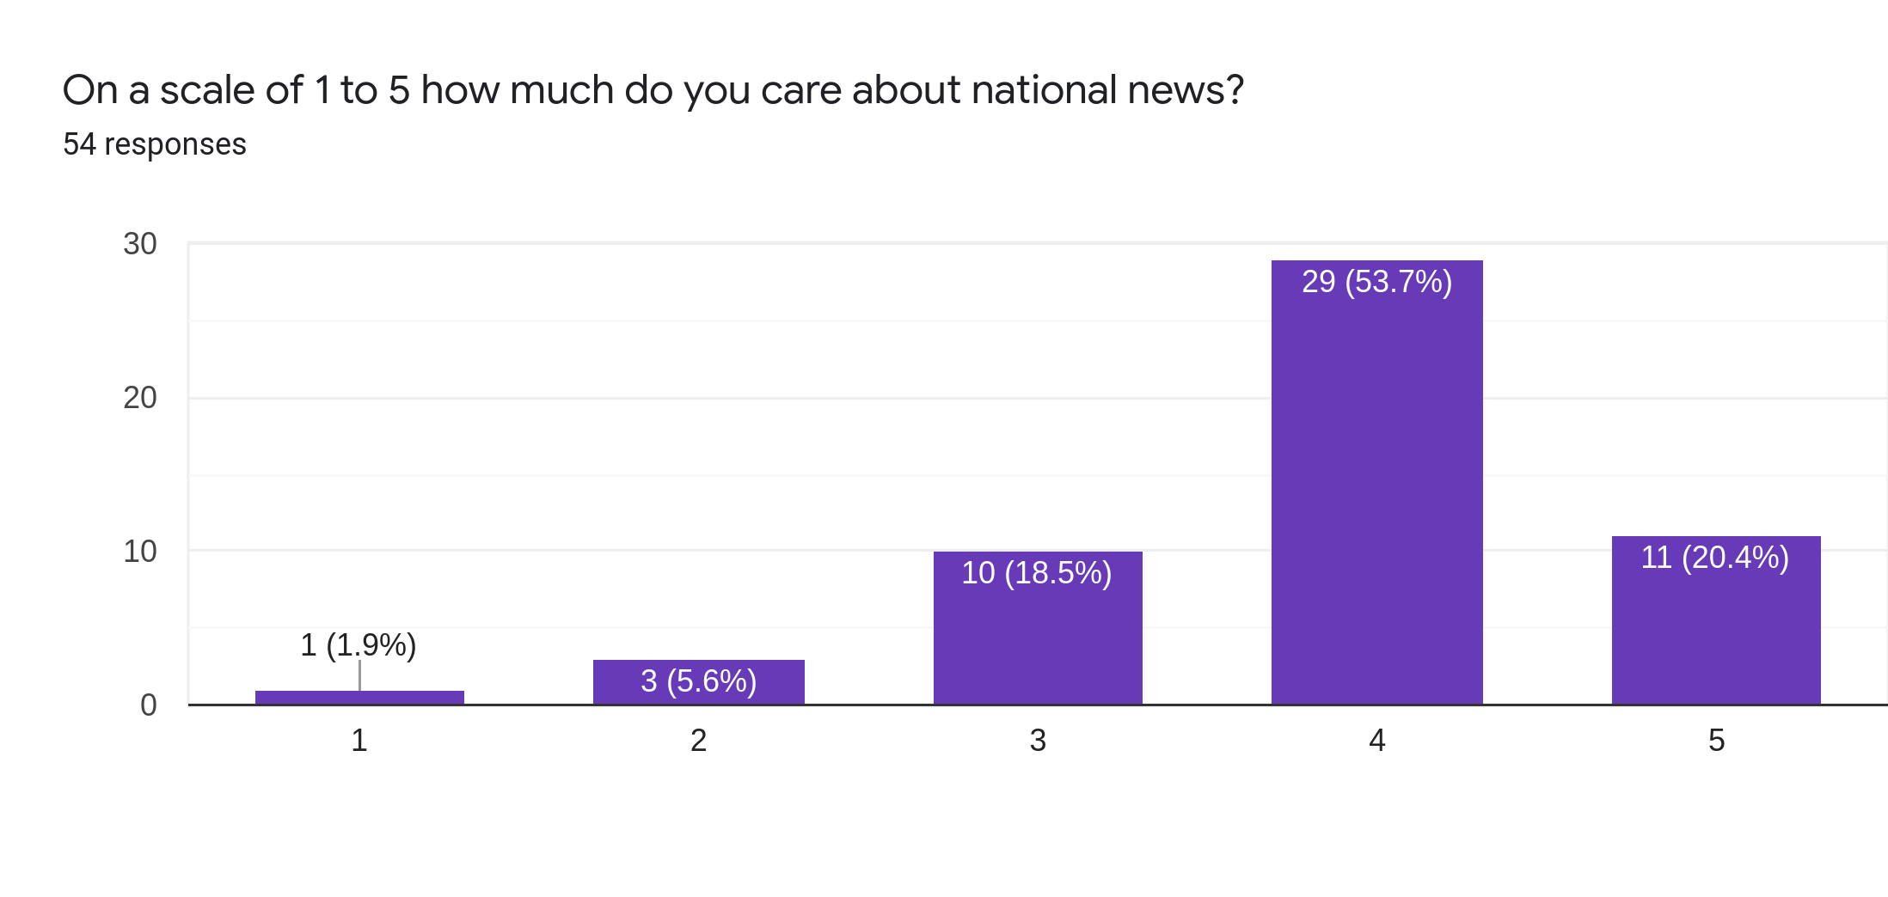

Slide 7
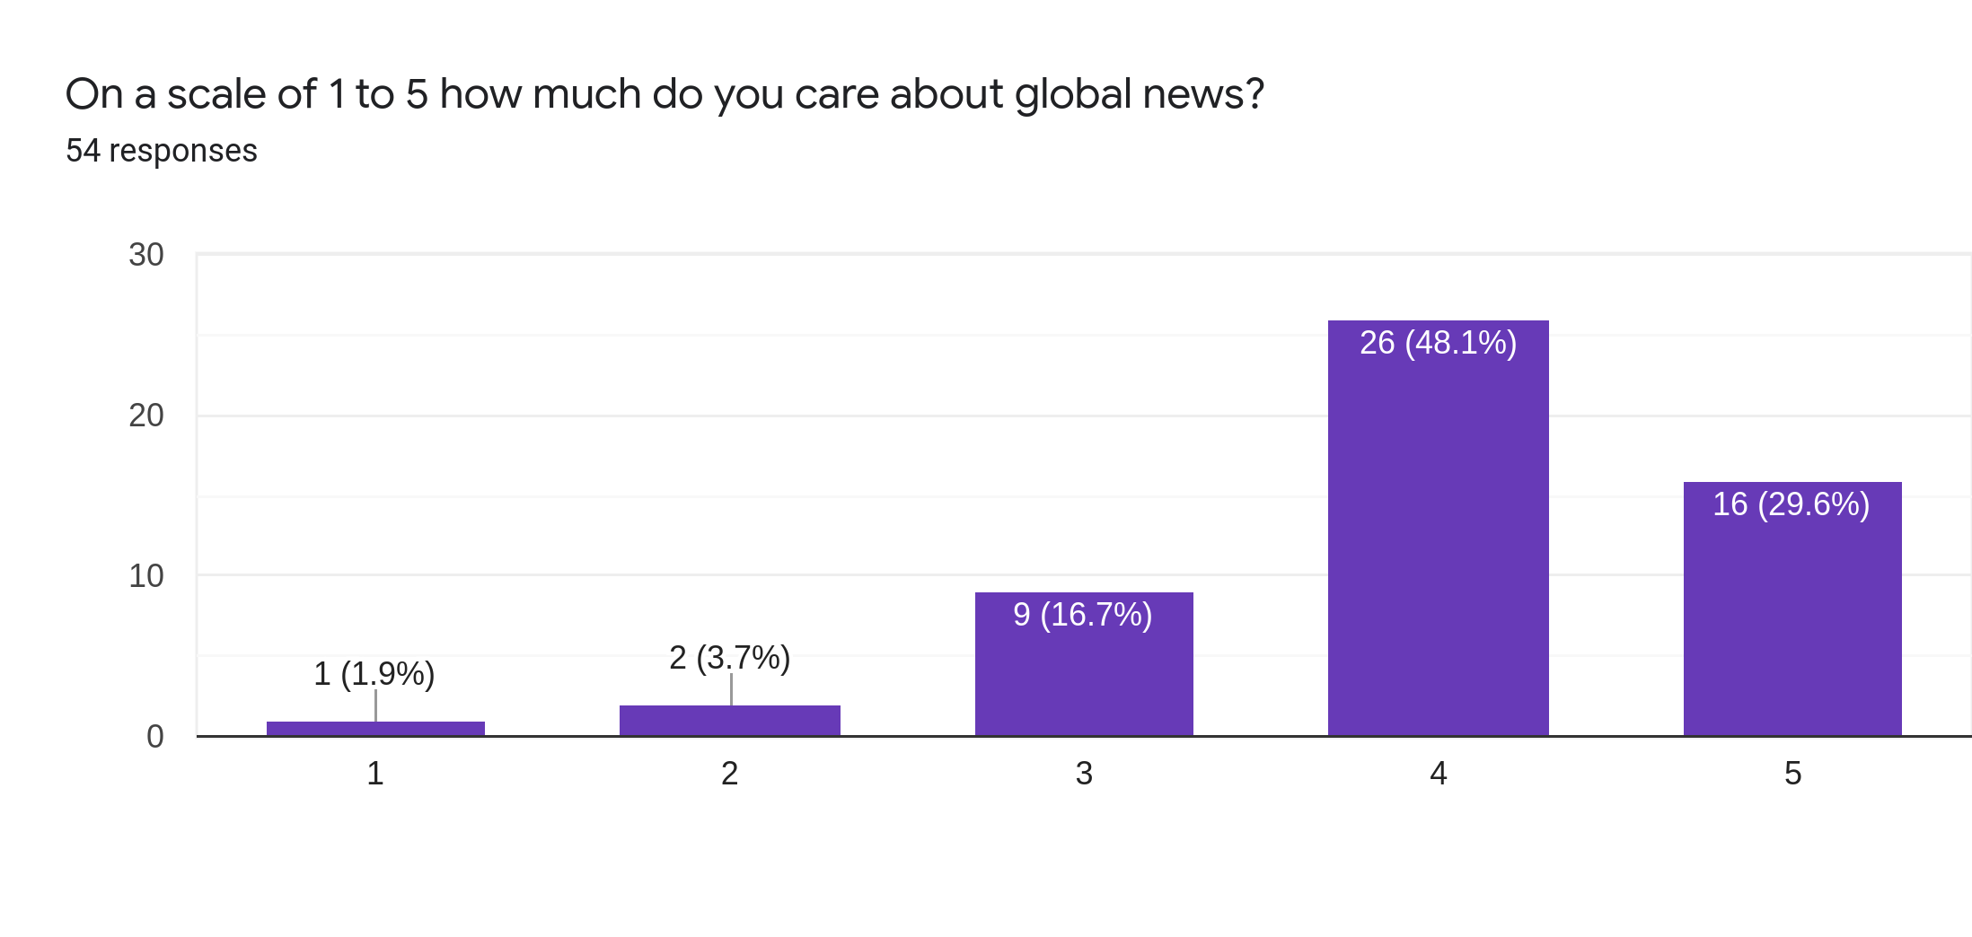

Slide 8
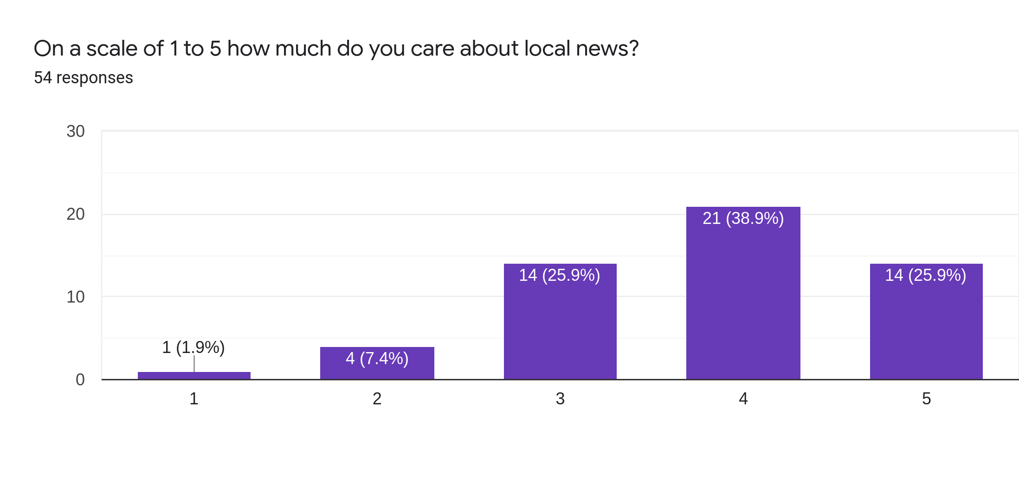

Slide 9
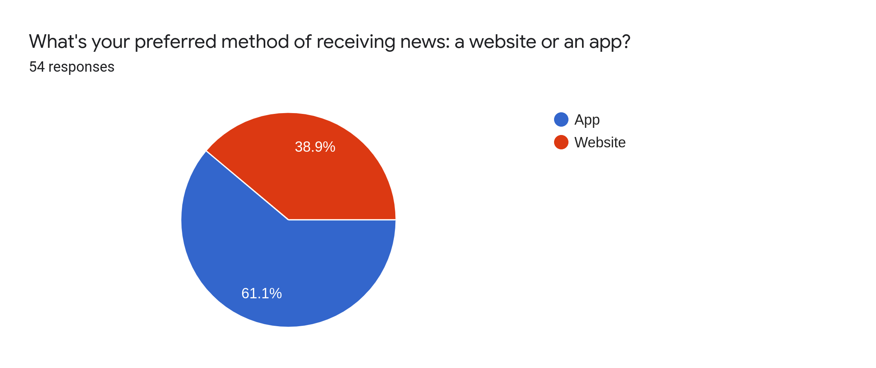

Slide 10
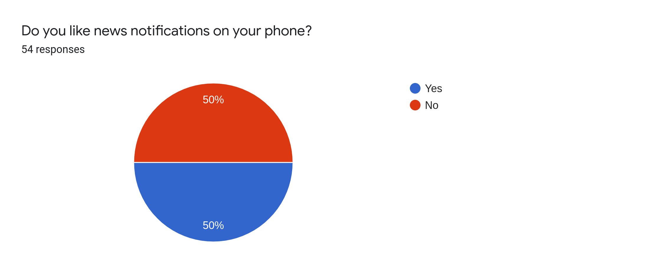

Slide 11
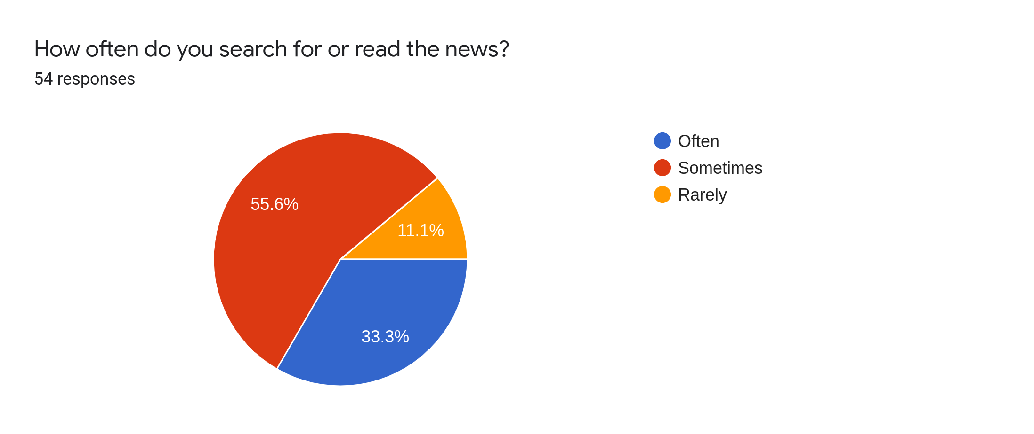

Slide 12
User story points planned
Allow users to reset password
Allow users to log out of the app
Allow users to see articles as marks on the map
Additional articles web scraping

Slide 13
User story points achieved
Allow users to reset passwords
Allow users to log out of the app
Additional web scraping

Slide 14
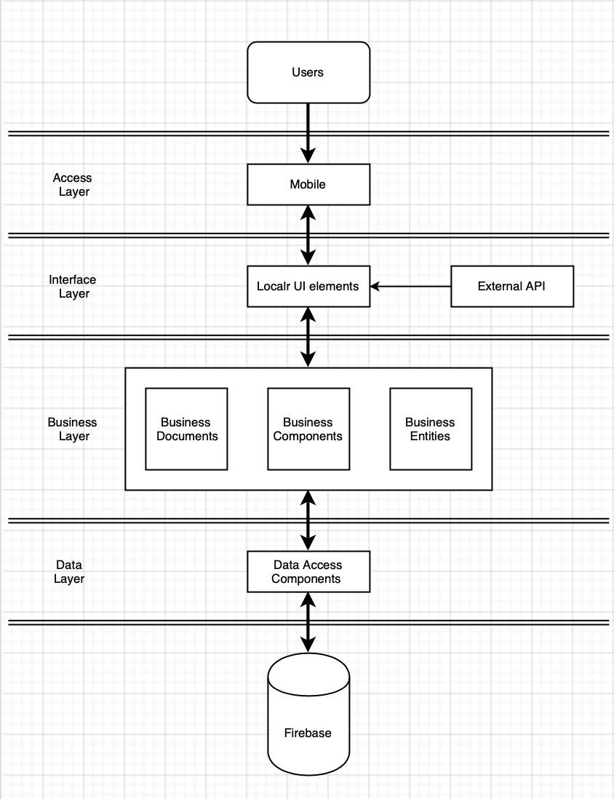
Architecture

Slide 15
Code Demo

Slide 16
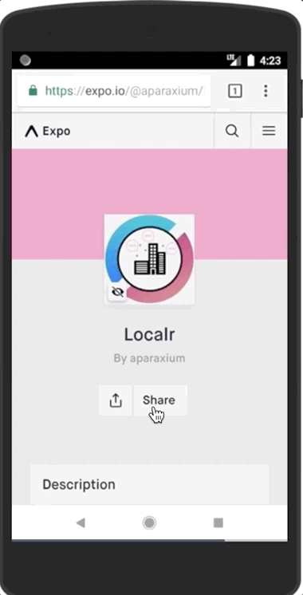
User Manual: Opening the Demo using Expo
USE THIS EMULATOR TO ACCESS THE APP:
Click "Open project using Expo"
Expo will open and display the Localr App
Notes:
riana

Slide 17
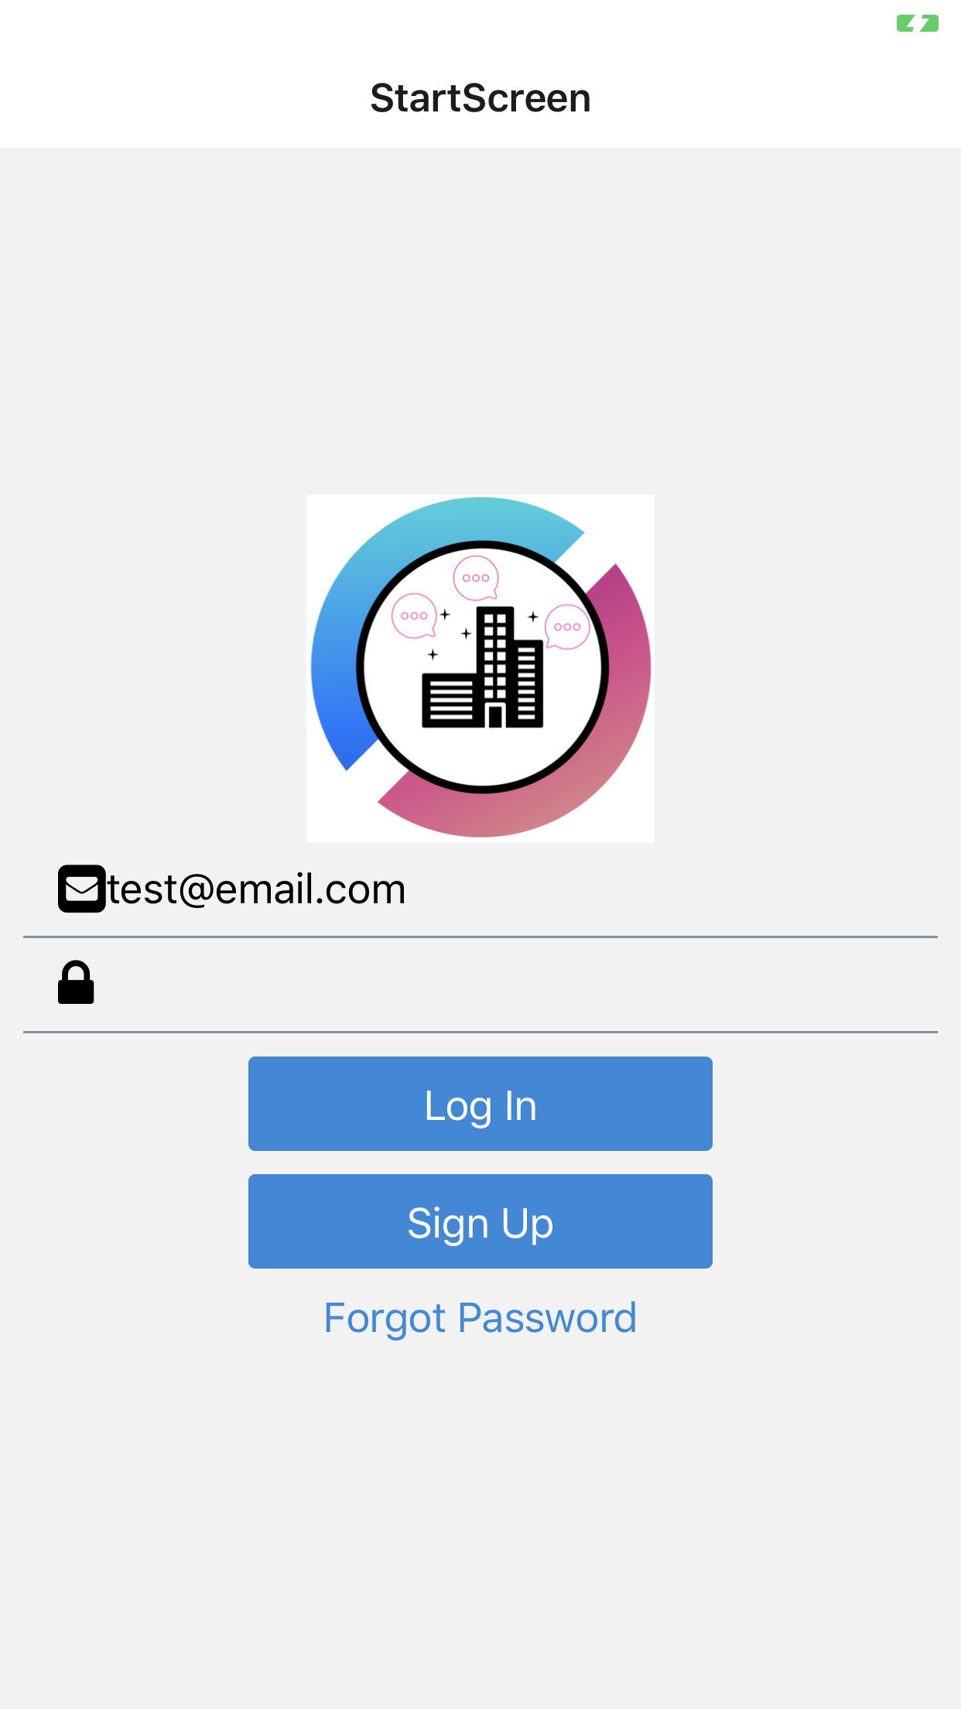
User Manual: User Sign Up
User enters an email address.
2. User inputs a password
1
2
3. User clicks on "Sign Up"
3
Notes:
riana

Slide 18
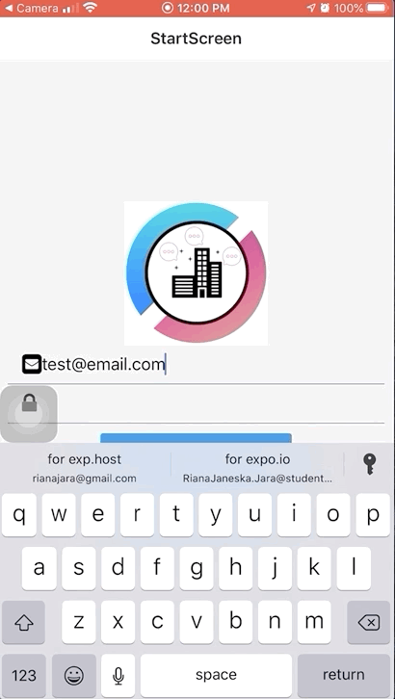
User Manual: User Log In
User enters the email address they signed up with.
2. User enters their password.
2. User taps on "Log In" button.
Notes:
riana

Slide 19
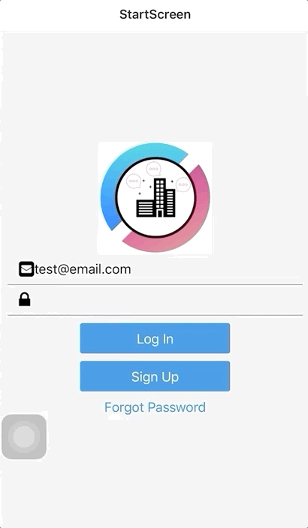
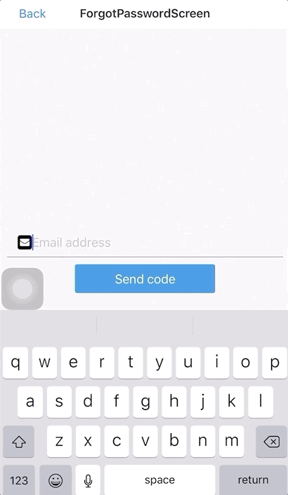
User Manual: User Forgot Password
User has the option to click "Forgot Password" if they have forgotten it.
User will then be redirected to a Forgot Password screen where they can input their email.
User can then resend password by clicking "Send Code"
Notes:
riana

Slide 20
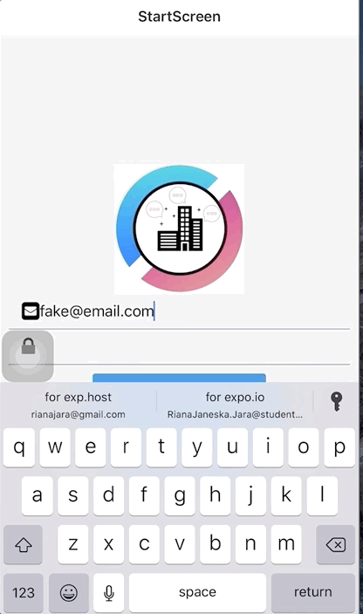
User Manual: User Log In (Incorrect Log In Credentials)
If user enters the wrong email/password. They will be prompted with an error message.
User can click on "Ok" button to sign in again
Notes:
riana

Slide 21
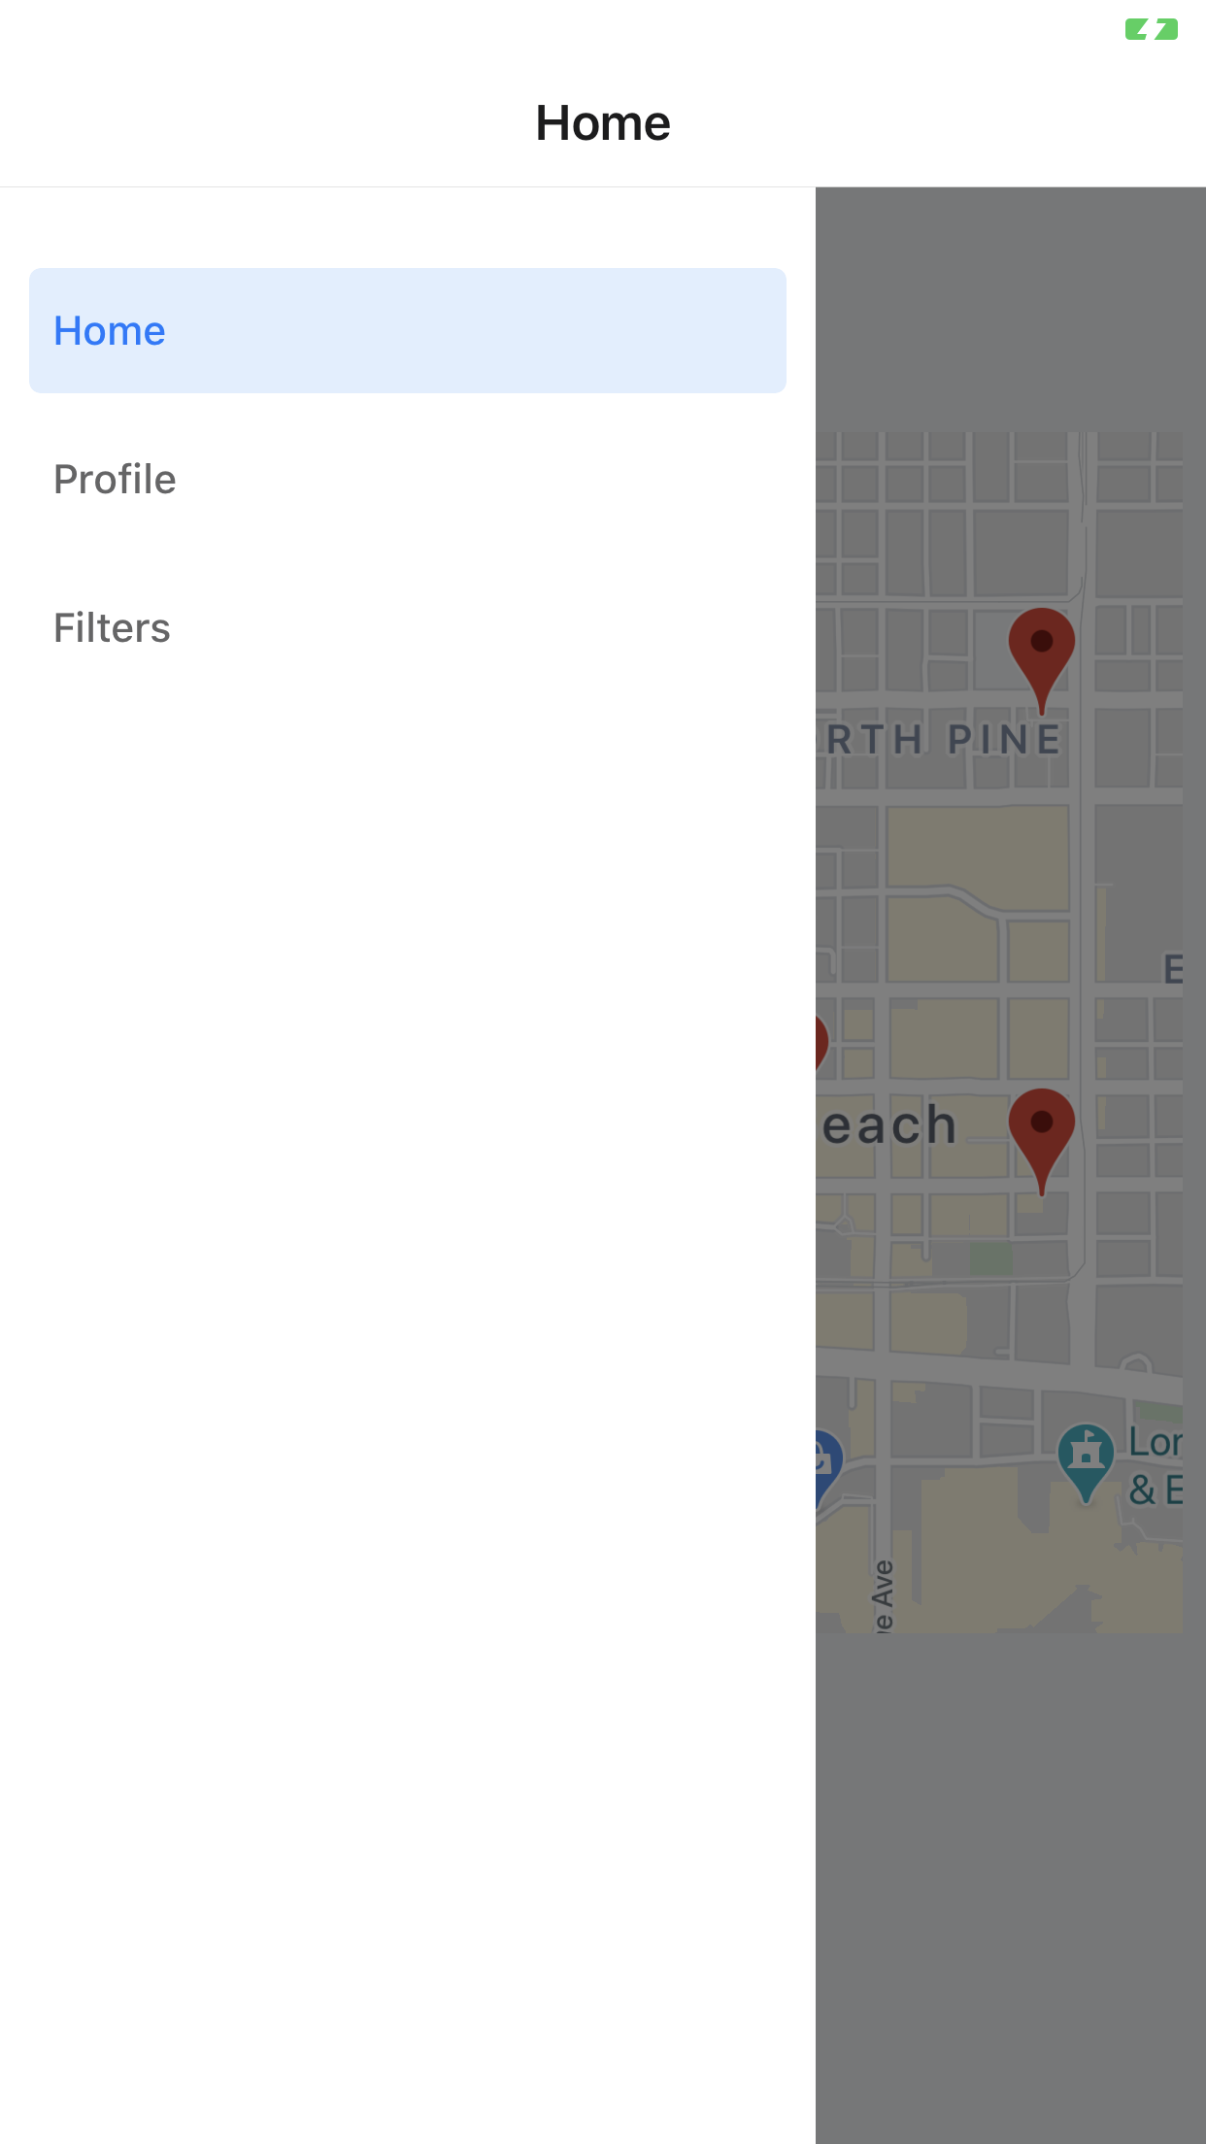
User Manual: Accessing the Maps Feature (Full Screen Map)
User should be able to tap on the "peeking" map (area highlighted) to access the full screen map feature.
Notes:
riana

Slide 22
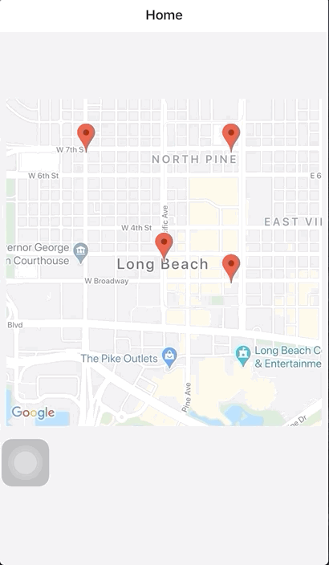
User Manual: Accessing the Maps Feature (Moving Around)
In order to look around the maps, the user can scroll through the map by dragging.
Notes:
riana

Slide 23
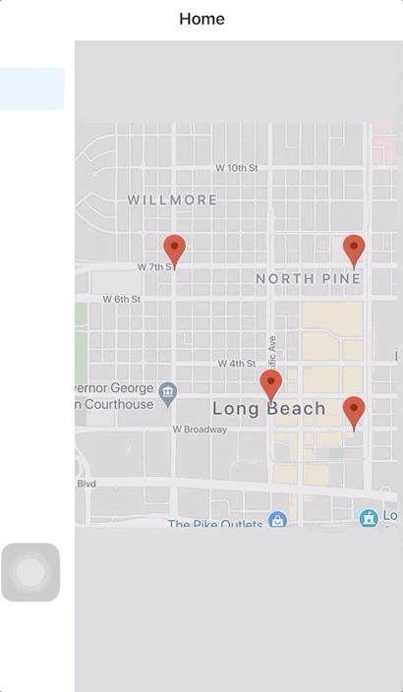
User Manual: Accessing the Menu
User can access the Menu bar by swiping slowly from the left-most edge of the screen towards the middle of the screen.
User can close the Menu bar by swiping slowly from the middle of the screen towards the left edge of the screen.
Notes:
riana

Slide 24
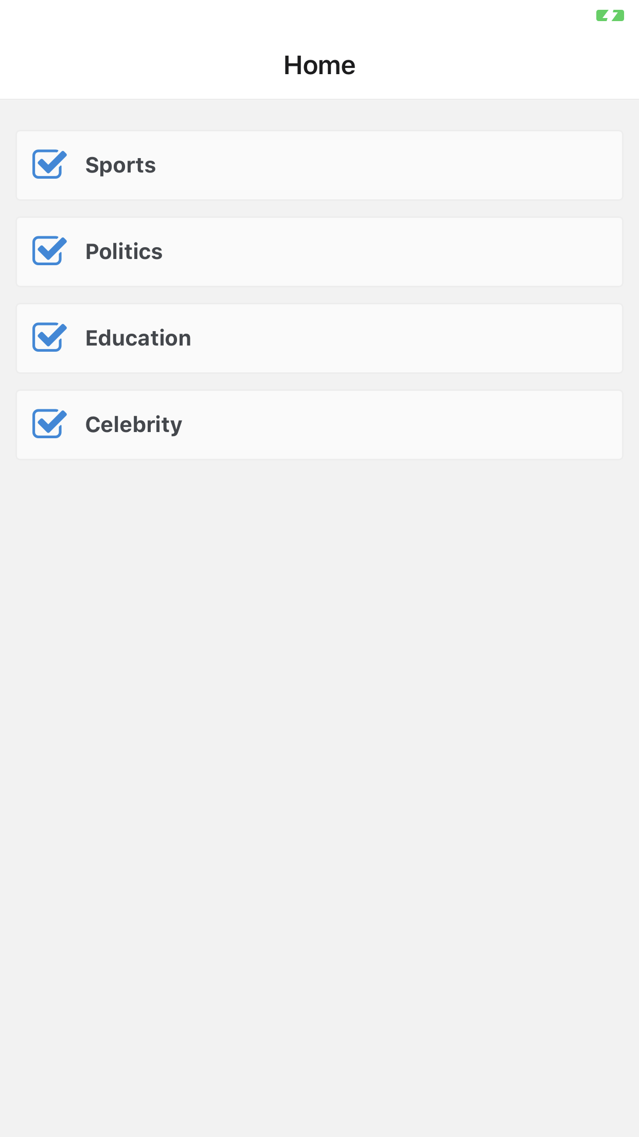
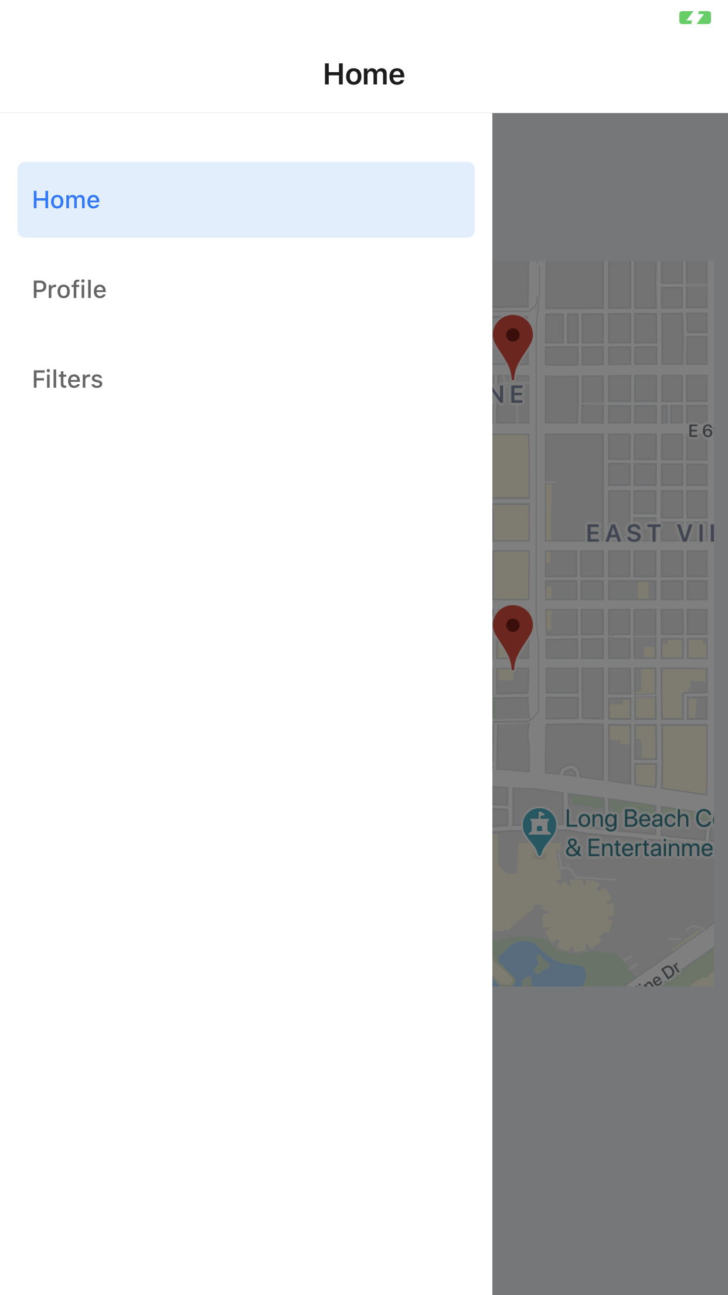
User Manual: Accessing the Filters Page
From the Menu bar, users can tap on the "Filter" button
User will then be redirected to the Filters page, where they can uncheck/check all the filters they have set for articles.
Notes:
riana

Slide 25
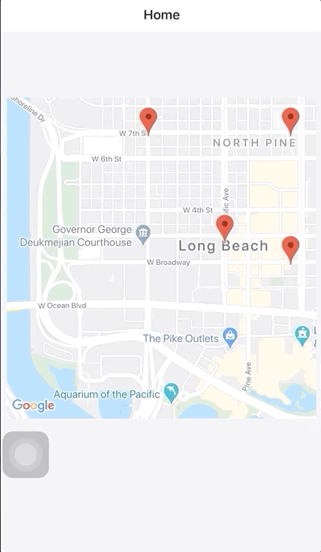
User Manual: Logging Out
Users can click Profile to log out
Users can then click "Log Out" to be redirected to the Log In Screen
Notes:
riana

Slide 26
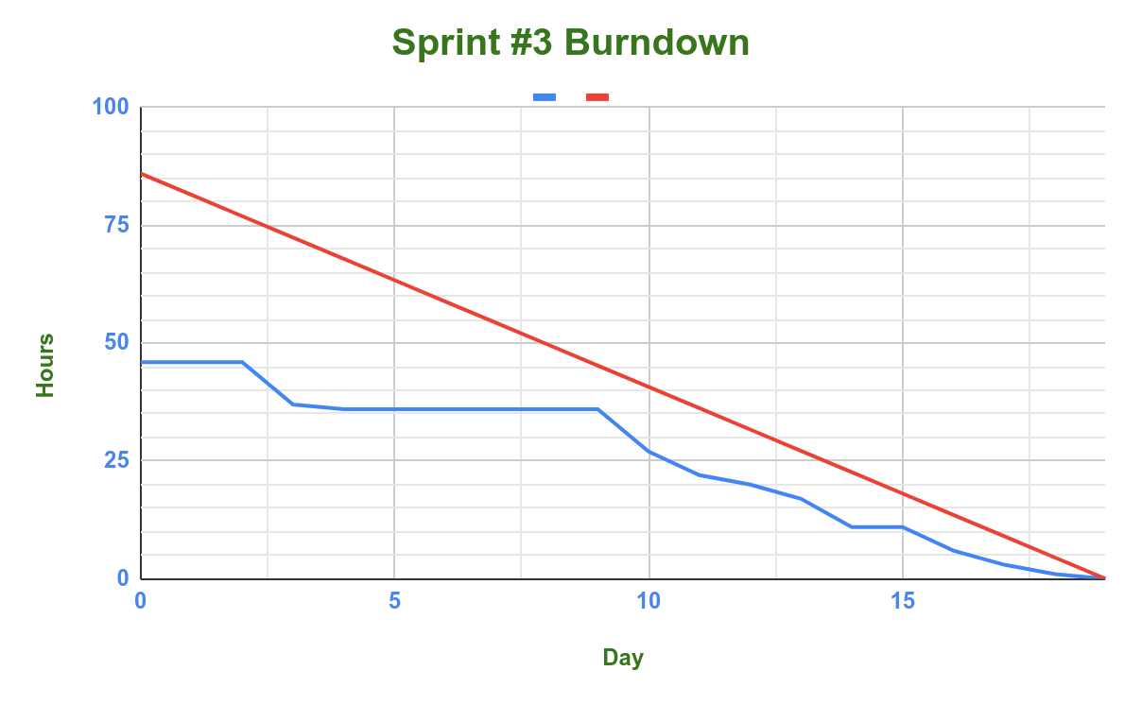
Burndown Chart

Slide 27
Sprint Goals
Deploy Machine Learning Model (1st iteration)
Finish login
Set up proof of concept article database
Display Articles
Finish user location settings

Slide 28
Sprint Retrospective
Work on collecting training data through web scraping.
Keep track of our progress from the trello board

